Slide 1
AUTO-गाड़ी
Analysis of the Automotive Industry

Slide 2
Presented By:
MD Iftear Ahmed (20103089)
Paras Gupta (20103107)
Smriti Chaudhary (20103140)
Mentored By: Mr. Rahul Aggarwal

Slide 3
Table of contents
01
02
03
04
Introduction
Literature Survey
Problem Statement
Research Gap

Slide 4
Table of contents
05
06
07
08
Methodology
Implementation
Conclusion
Result

Slide 5

01
INTRODUCTION

Slide 6
INTRODUCTION
The term "Automotive Industries" refers to all businesses and endeavours concerned with the production of motor vehicles, including the majority of its parts, such as their engines and bodywork, but excludes their tyres, batteries, and fuel.
The automotive industry continues to face a growing number of challenges and pressures. Cost pressure, competition, globalization, market shifts, and volatility are all increasing.
The background of the "AUTO-GAADI" project would involve data analysis and machine learning techniques to predict the price of a car and analyze the trends in car sales.

Slide 7
INTRODUCTION
To carry out this project, you would need access to a large dataset of car sales information, including factors such as car price, model, year, mileage, condition, location, and price. This data can be collected from various sources such as online car sales platforms, car dealerships, and public records.
The project would involve data cleaning and preparation to ensure that the data is accurate and consistent. This would include removing any missing or duplicate, converting data into a standardized format, and identifying any outliers or anomalies.
Overall, the project would require a strong understanding of data analysis and machine learning techniques, as well as a background in programming and statistics.

Slide 8
INTRODUCTION
The goal of this web app is to understand key performance indicators for automotive industry in the US and to predict the price of the Car with respect to Car Age, Fuel Type, Transmission Type and others .
We have trained our model with different datasets taken from “Data.world “ and The data consisted of 48 car brands and in total 915 different car models.
This Price Prediction in our project is going to help the user to buy and sell a car with an unbiased price easily and without any loss .

Slide 9
02
LITERATURE SURVEY

Slide 10
LITERATURE SURVEY
To conduct a literature survey on the innovation of an AUTO-GAADI,
we explored the existing systems of several company to gain more insight into the topic. The results of our survey are presented below.
There is an online platform TrueCar that provides pricing transparency and market insights to help consumers and dealers make informed car buying and selling decisions.
CarGurus - an online automotive marketplace that provides pricing insights, dealer reviews, and car valuation tools to help buyers and sellers make informed decisions.

Slide 11
03
RESEARCH GAP

Slide 12
RESEARCH GAP
Incorporating non-linear relationships: Many existing car price prediction models assume linear relationships between variables. However, there may be non-linear relationships that could be important for predicting car prices. Further research could explore the use of non-linear models to improve accuracy.
Incorporating unstructured data: Many car price prediction models rely on structured data such as car make, model, year, and mileage. However, unstructured data such as user reviews or social media sentiment could also be useful for predicting car prices. Further research could explore how to incorporate unstructured data into car price prediction models.
Addressing data quality issues: The accuracy of car price prediction models can be impacted by data quality issues such as missing or incorrect data. Further research could explore how to address these issues to improve the accuracy of car price prediction models.

Slide 13
04
PROBLEM STATEMENT

Slide 14
PROBLEM STATEMENT
The current car sales industry faces a challenge in terms of transparency and consistency in pricing. There is a lack of standardization in pricing methods, and prices can vary significantly across different regions, dealerships, and sales channels. This can create confusion for buyers, and it can be difficult for sellers to determine the fair market value of a vehicle.
AUTO-GAADI can provide more reliable and accurate pricing information to help buyers and sellers make informed decisions.

Slide 15
05
METHODOLOGY

Slide 16
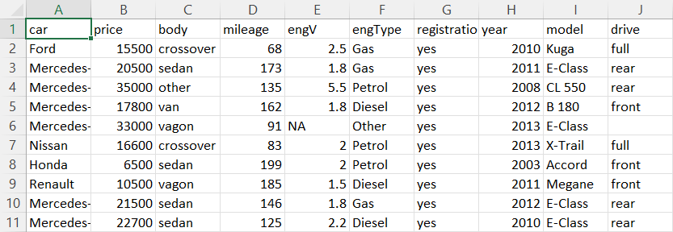
Snippet of Dataset Used:

Slide 17
ALGORITHM USED:
Random Forest Regression is a type of machine learning algorithm that is used for predicting continuous values (regression). It is an ensemble learning method that combines multiple decision trees to improve the accuracy and robustness of the prediction.
The basic idea behind the random forest regression algorithm is to construct multiple decision trees on randomly selected subsets of the training data, and then aggregate the predictions of all the trees to arrive at the final prediction. Each decision tree is constructed based on a random subset of features, and at each node of the tree, the best split is chosen from a random subset of features.
The final prediction of the random forest regression model is the average of the predictions of all the decision trees. This averaging process helps to reduce the variance of the predictions and improve the overall accuracy of the model.

Slide 18
Various Python libraries are used in this project like:
Numpy
Pickle
Pandas
Sklearn
Json
Plotly
Plotly.express , plotly.graph_objs
Random Forest Regressor

Slide 19
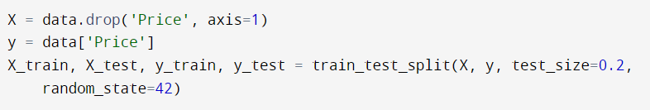
CODE SNIPPET
Training and Testing :
Random Forest Regression model and fit it to the Training Data:

Slide 20
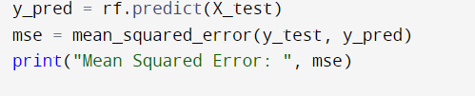
CODE SNIPPET
Testing data and evaluate the performance of the model:

Slide 21






TECH-STACK used

Slide 22
06
IMPLEMENTATION

Slide 23
STRUCTURE OF THE PROJECT
The home page consists of an about section, a services section and a contact section where in the services section you will find two options i.e, Car Sales Analysis in US and Car Price Prediction.
The First Section consists of Car Sales Analysis in US where different queries are answered in the form of visualization related to Car Sales in US. The user get to know about the different trends in automotive industry.
Using the above analysis, we can get a complete understanding about the automotive industry.

Slide 24
STRUCTURE OF THE PROJECT
The Last Section consists of Used Car price prediction where the Machine Learning Model uses the Random Forest Regression to predict the price of the car.
The prediction section consists of forms which take few different feature as input from the user in a given specified range. The most relevant features are taken into consideration for prediction also these features
So, with this the User can get a complete analysis of the current trends related to automotive industry and Car Sales.

Slide 25
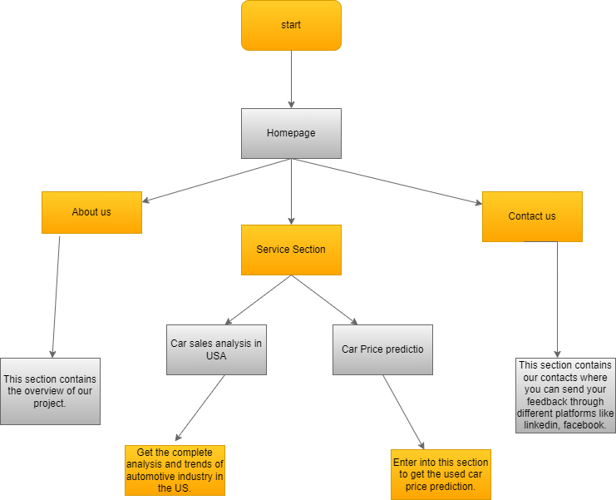
FLOWCHART

Slide 26
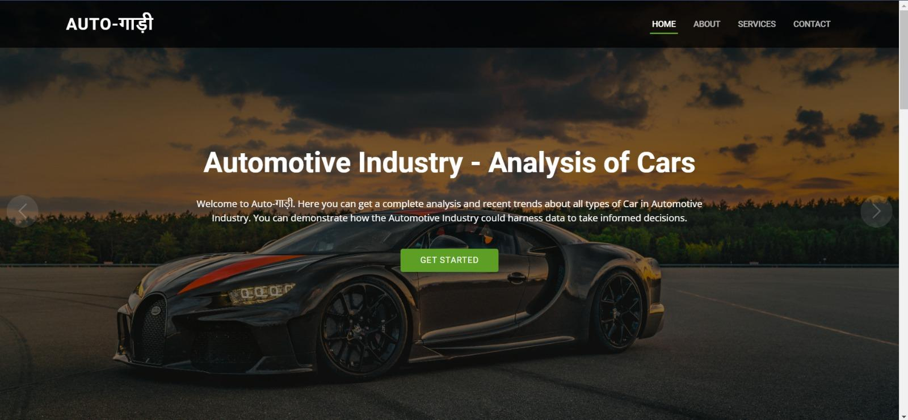

Slide 27
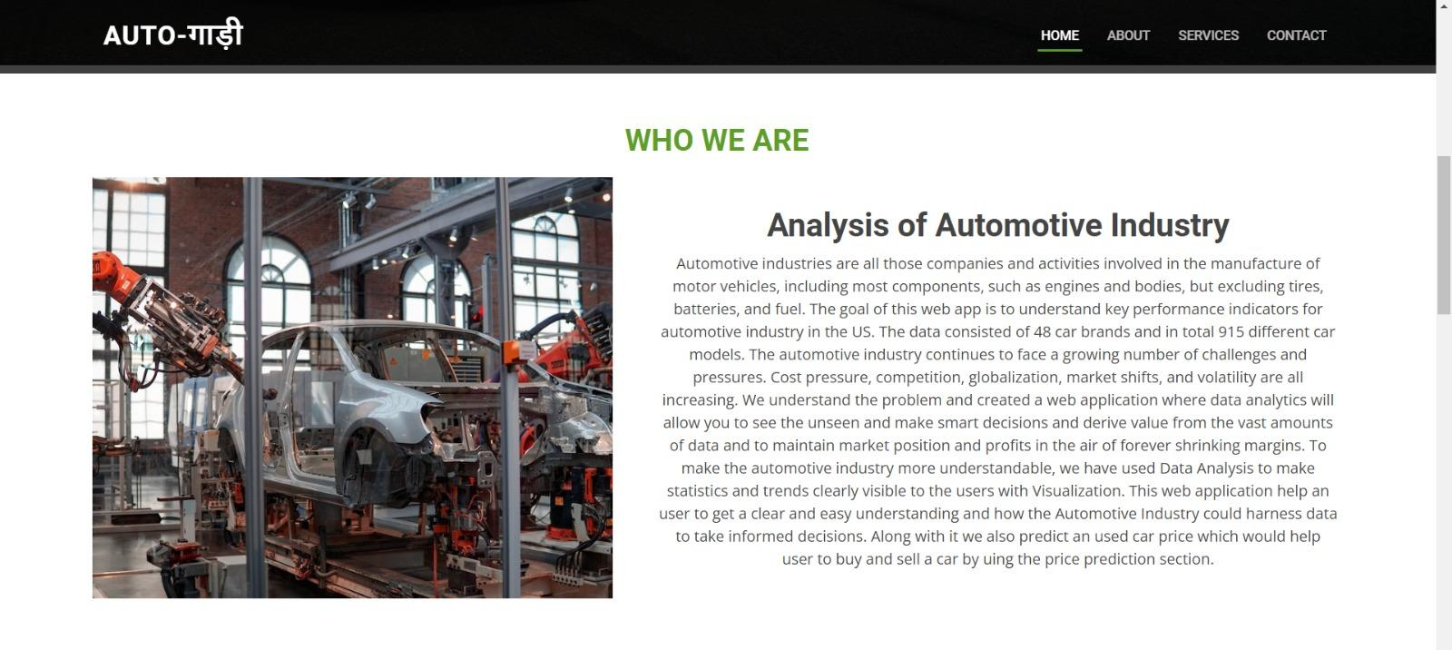

Slide 28
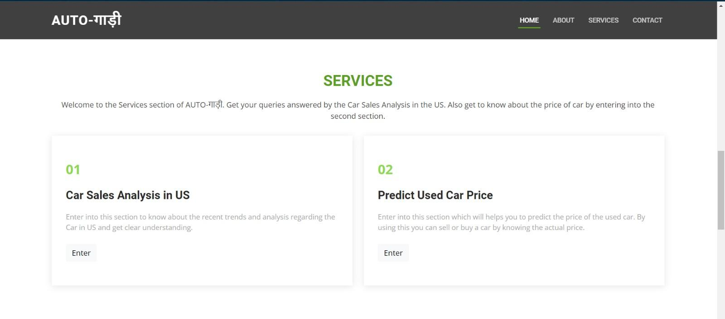

Slide 29
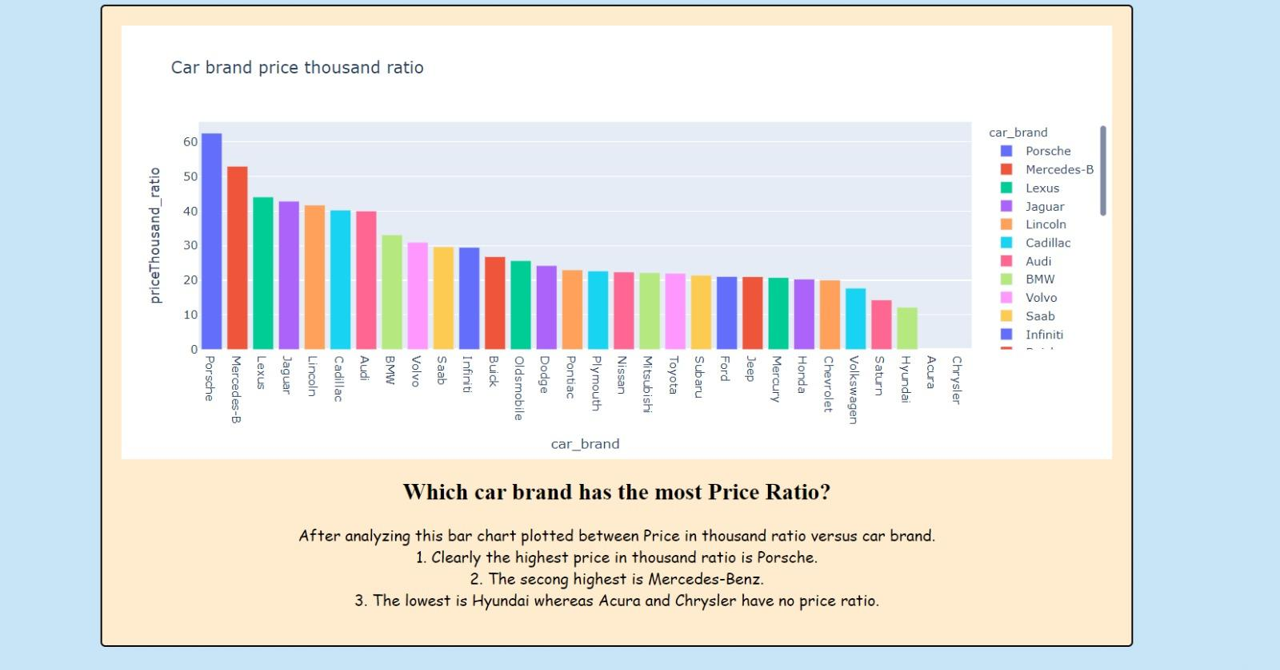

Slide 30
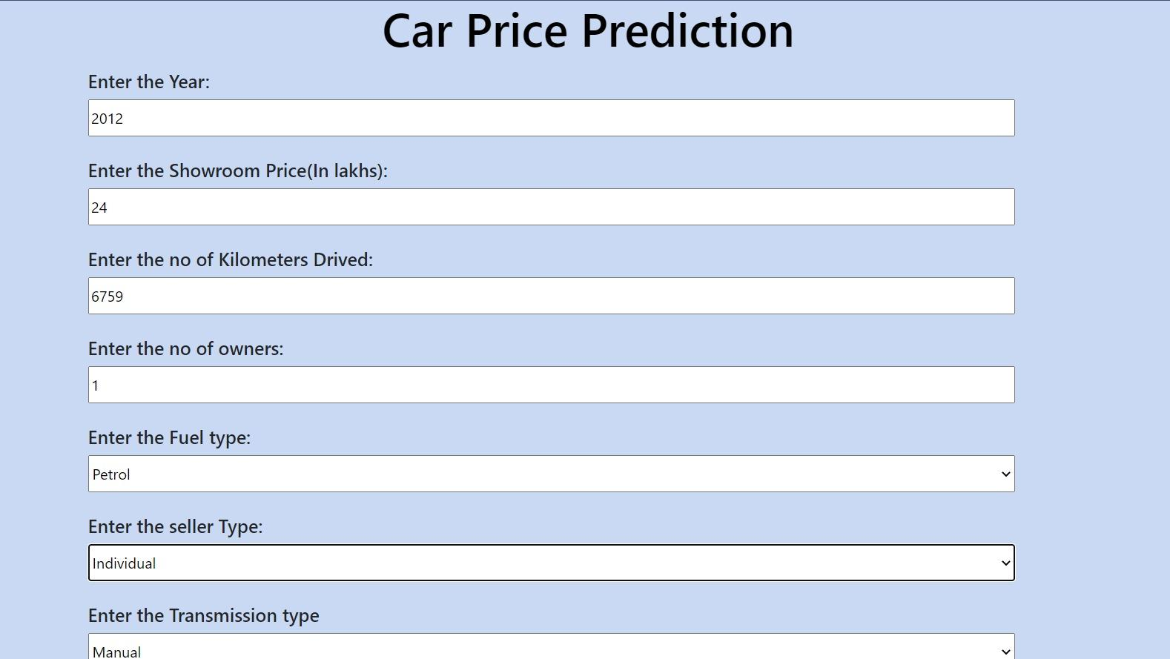
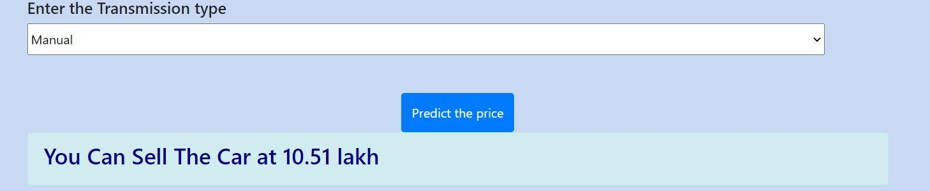

Slide 31
07
RESULT

Slide 32
RESULT
The AUTO-GAADI system should provide tangible benefits such as cost savings, increased sales, and improved customer satisfaction. It should also help reduce the risk of overpricing or underpricing cars, leading to more balanced supply and demand in the market.
Finally, the system should be able to keep up with changing market trends and customer preferences, ensuring its continued relevance and usefulness over time and patterns in car sales data, helping consumers to make informed decisions about pricing, inventory management, and sales strategies .

Slide 33
08
CONCLUSION

Slide 34
CONCLUSION
The AUTO-GAADI project is a promising initiative that has the potential to revolutionize the car sales industry by providing buyers and sellers with more accurate and reliable information about car prices and market trends.
However, to ensure the success of the project and maximize its social and environmental impact, it is important to conduct a thorough feasibility study, perform rigorous risk analysis, and engage with stakeholders throughout the design and implementation process.

Slide 35
REFERENCES
“Predicting the Price of Used Cars using Machine Learning Techniques”, Sameer Chand Pudaruth, Computer Science and Engineering Department, University of Mauritius, Reduit, MAURITIUS
“US Auto Production and Price Prediction in the Context of Multiple Regression Analysis”, Qilin Li, Department of Economics, University of California, Irvine, the U.S.
“The Framework of Car Price Prediction and Damage Detection Technique”, Muhammad Kashif Shaikh, Department of Software Engineering, Sir Syed University of Engineering & Technology, Karachi, Pakistan.
Web Development Tools: W3Schools.
Stack Overflow
Python tools: W3Schools.
Youtube channels: Code with harry

Slide 36
Thanks!

